Slide 1
SCOAP Analysis Tool
Mentor:
Dr. Bibhas Ghoshal
Divyansh Tripathi - IEC2017010
Sahil Goyal - IEC2017086
Pulkit Goel - IEC2017019

Slide 2
Motivation
“Sections in a circuit with low controllability and observability are considered potential areas for implementing Trojans [2]”
to quantify the insertion and detection of a malicious hardware introduced in the circuitry.
a mathematical model to analyse each and every net within a circuit.
SCOAP
to convert a given circuit description into a form suitable for this analysis.

Slide 3
Approach
Testability parameters
The Sandia Controllability/ Observability Analysis Program (SCOAP) calculates six functions which characterize the controllability/observability properties of a digital circuit.
These functions can be computed efficiently, and they accurately measure the difficulty of controlling and observing the logical values of internal nodes from consideration of circuit topology alone.
Combinational controllabiltiy of logic 0 [CC0]
Combinational controllabiltiy of logic 1 [CC1]
Combinational observability [CO]
Sequential controllabiltiy of logic 0 [SC0]
Sequential controllabiltiy of logic 1 [SC1]
Sequential observability [SO]

Slide 4
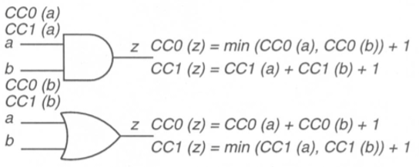
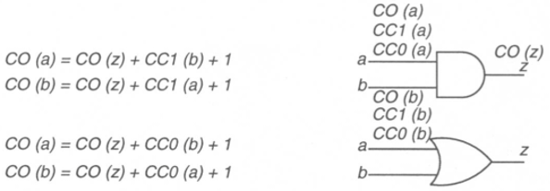
Mathematical model
Controllability
Observability
The effort to set the logic value to a signal
The effort to observe the state of a signal

Slide 5
OUR APPROACH
Verilog Code: Schematic
YOSYS
RTL intermediate description
PARSER
Desired gate-level netlist
SCOAP TOOL
SCOAP controllability and observability

Slide 6
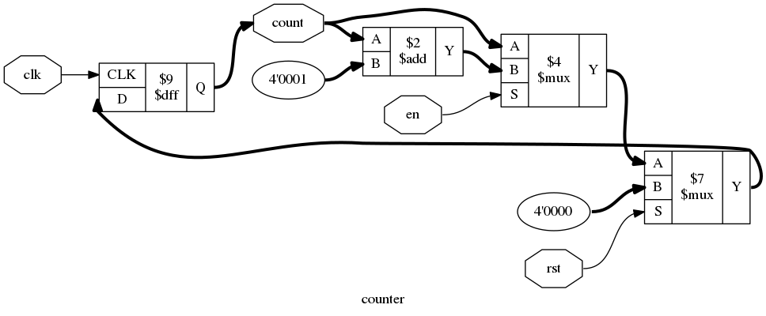
YOSYS
It is a framework for Verilog HDL synthesis .
RTL circuit is represented as a graph of circuit elements (registers) and signals.
Such a graph, when encoded as a list of cells and connections, is called a Netlist.
The gate level netlist obtained via scripting in YOSYS generates a JSON file consisting of ports and interconnections of cells.
This file is read through Python scripting in further stages.

Slide 7
Parser
To convert from Verilog to ISCAS89 Netlist, we used Python to write our Script
Json library in Python was helpful in dealing with output we got from Yosys
Using Top to Down Recursive approach, we parse the Json
We have named the netlist in such a way that the designer will be able to make it out quite easily which net belongs to which submodule

Slide 8
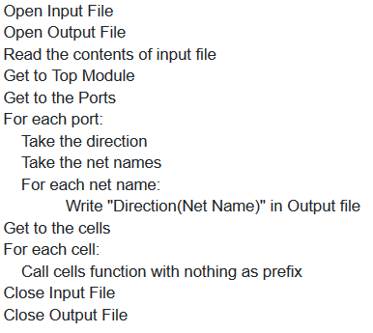
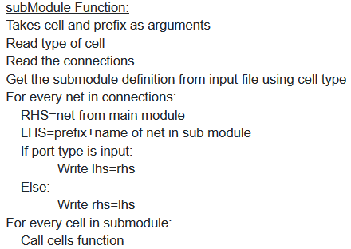
Pseudo Code

Slide 9
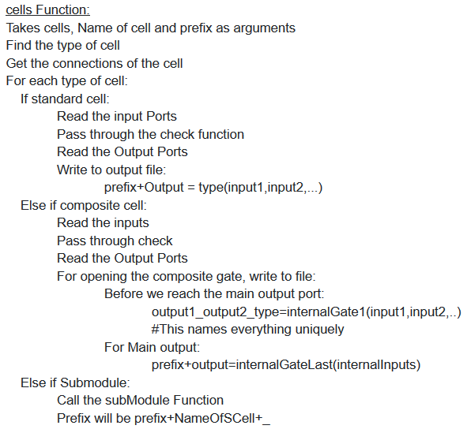
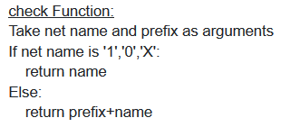
Pseudo Code

Slide 10
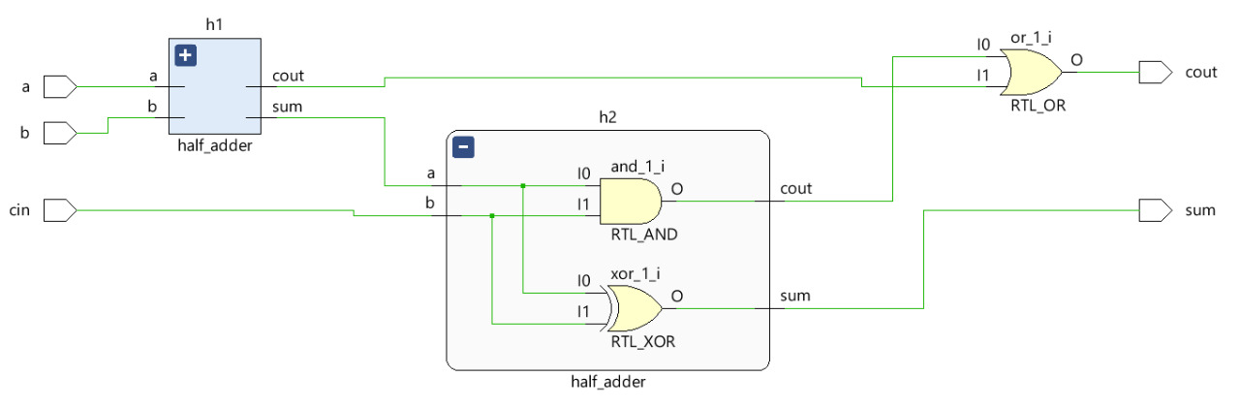
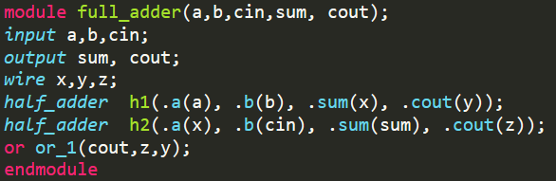
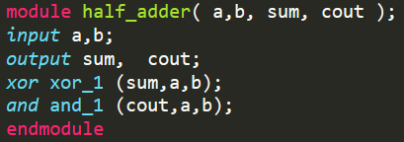
Illustration: Full Adder
Verilog Code

Slide 11
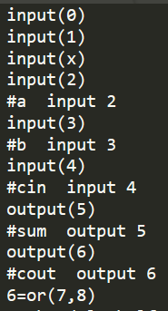
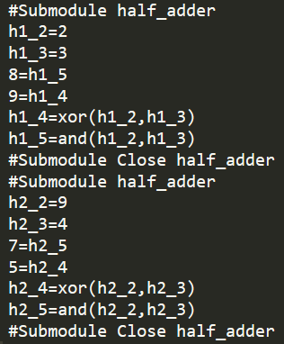
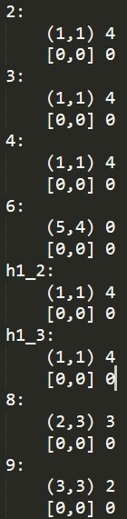
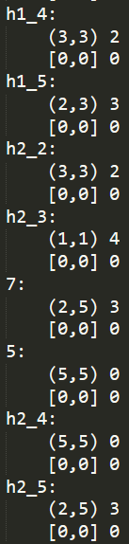
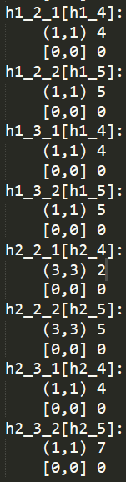
Illustration: Full Adder
Output from Parser
Controllability & Observability values

Slide 12
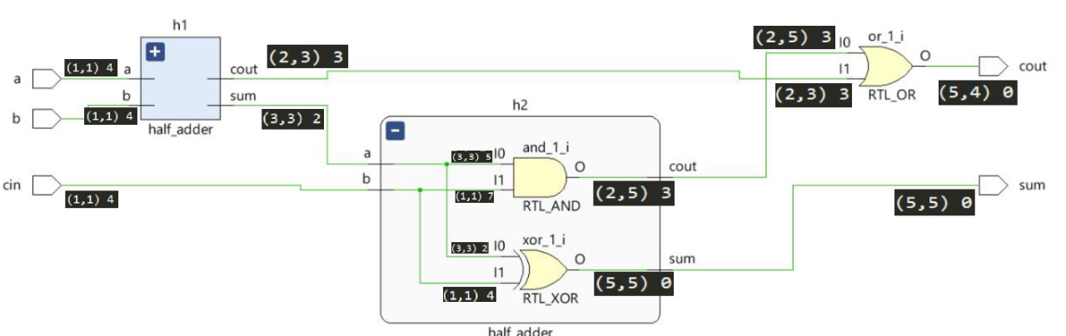
SCOAP Analysis- the final output

Slide 13
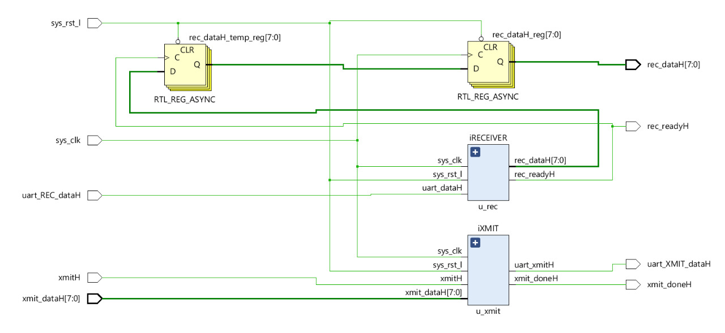
Benchmark - RS232-T300
Information Leaking; Internal Time Based Triggering

Slide 14
THE WRAPPER
_________________________________________________________________________________________________________________________________________________________________________________________
YOSYS
SCOAP
WRAPPER
Integrated tool that can be operated from command prompt window and executes all the operations chronologically.
Batch file created using VB Scripting
PARSER

Slide 15
Conclusion
Through this project,
we depicted how to quantify the ease or difficulty to control and observe signal values throughout the circuit.
we converted the HDL description of a circuit into its gate-level netlist.
we parsed the netlist to work out every wire as a connection of ports to and from standard library cells.
Future Work
this tool could be used to further analyse the potential locations to inject or detect any trojan
design modifications could be proposed post analysis using this tool

Slide 16
References
[1] H. Salmani, M. Tehranipoor, and R. Karri, ”On Design vulnerability analysis and trust benchmark development”, IEEE Int. Conference on Computer Design (ICCD), 2013.
[2] B. Shakya, T. He, H. Salmani, D. Forte, S. Bhunia, M. Tehranipoor, “Benchmarking of Hardware Trojans and Maliciously Affected Circuits”, Journal of Hardware and Systems Security (HaSS), April 2017.
[3] ESSENTIALS OF ELECTRONIC TESTING FOR DIGITAL, MEMORY AND MIXED-SIGNAL VLSI CIRCUITS by Michael L. Bushnell and Vishwani D. Agrawal.
[4] Clifford Wolf. The Yosys Open Synthesis Suite. http://www.clifford.at/yosys/
[5] W. Keiner and R. West, ”Testability Measures,” AUTOTESTCON, pp 49-55 (1977).
[6] Testability Measurement Tool https://sourceforge.net/projects/testabilitymeasurementtool/
[7] J. E. Stephenson and J. Grason, ”A Testability Measure for Register Transfer Level Digital Circuits,” Proc. 6th Fault-Tolerant Computing Symposium, pp 101-107 (1976).
[8] Breuer and Associates, TEST/80–An Advanced ATG System for Digital Circuits, Report 1-77

Slide 17
Thank You!
Comments and Suggestions?

